Slide 1
The battle of Neighbourhoods
KP Realtor Inc.

Slide 2
Introduction/Business Problem
  Identify the best location(Neighbourhood) of Toronto for client (Retired Couple) to buy their first home that fits their requirements
    Neighbourhood should have:
    Parks
    Pet friendly places
    Drug Store Restaurants
    Coffee shops
    Trails
    Music friendly places

Slide 3
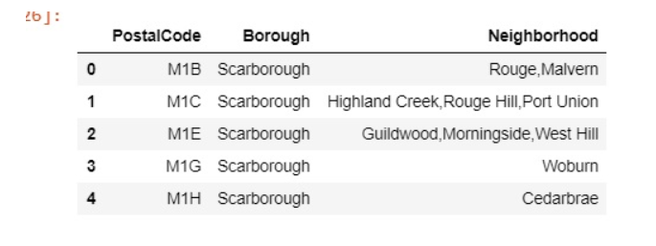
Data
Data 1: list of Borough and neighbourhood associated with the postal codes of Toronto city https://en.wikipedia.org/wiki/List_of_postal_codes_of_Canada:_M

Slide 4
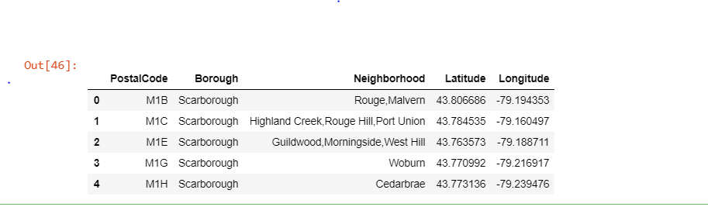
Data
Data 2: Toronto city geographical coordinates from the Foursquare API for neighborhood venues in Toronto
geographical data were also for Toronto from http://cocl.us/Geospatial_data

Slide 5
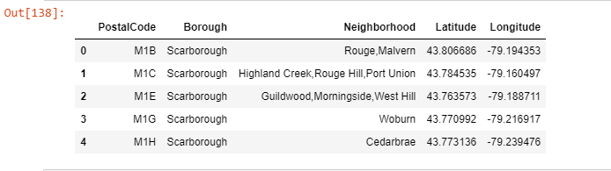
Methodology
Imported neighbourhood data with postal codes and merged with the geographical data for Toronto to assign respective longitude and latitude

Slide 6
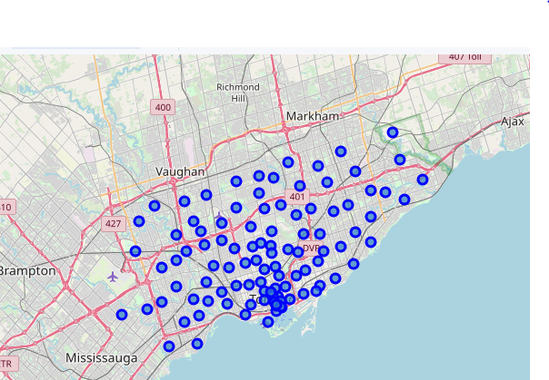
Methodology
Foursquare API - get venues surrounding neighbourhoods of Toronto

Slide 7
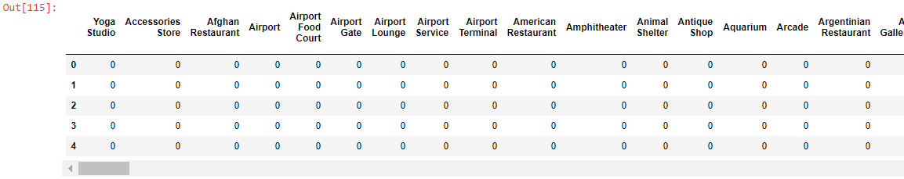
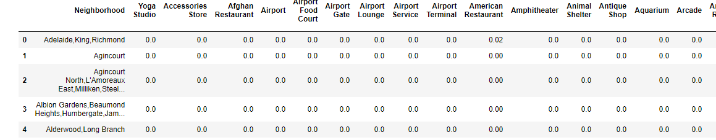
Methodology
Data wrangling/editing for analysis and identify Top 5 most venues for each neighbourhood and 1st to 10th most common venues for neighbourhoods

Slide 8
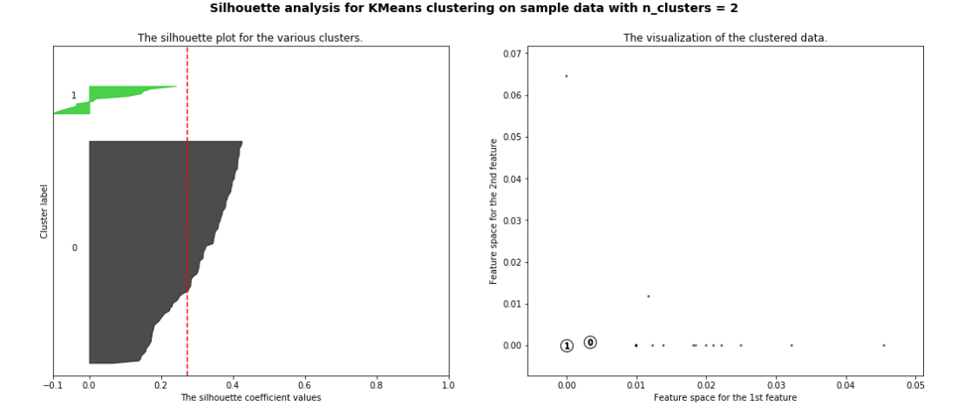
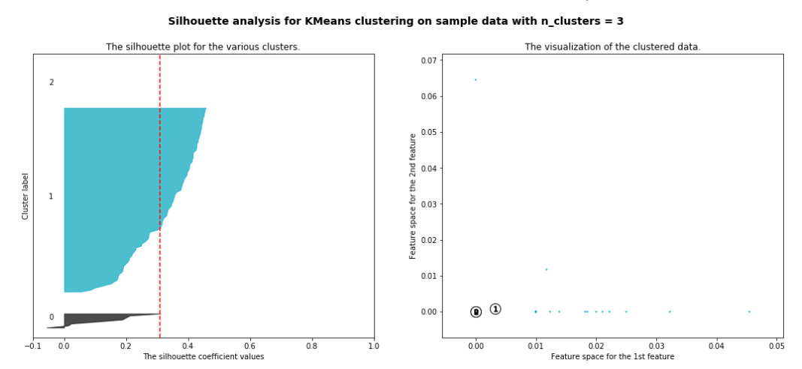
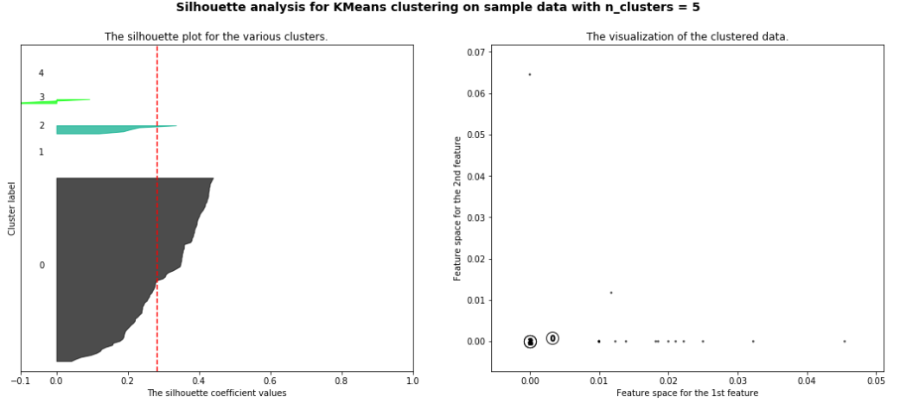
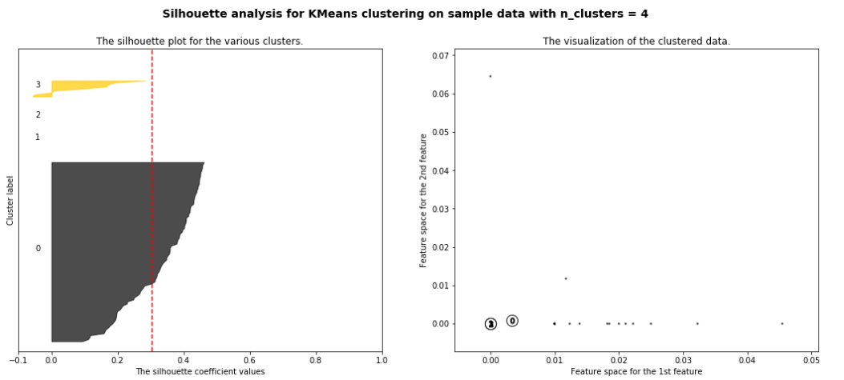
Methodology
  KMeans clustering

Slide 9
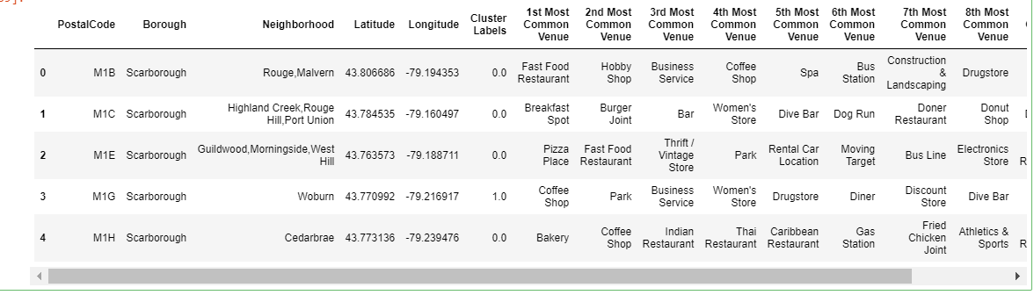
Methodology
  Dataset (Neighbourhoods) divided in 3 clusters

Slide 10
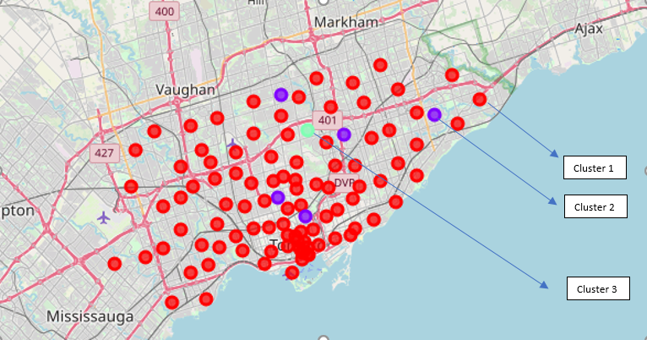
Methodology
  Dataset (Neighbourhoods) divided in 3 clusters based on most common venues

Slide 11
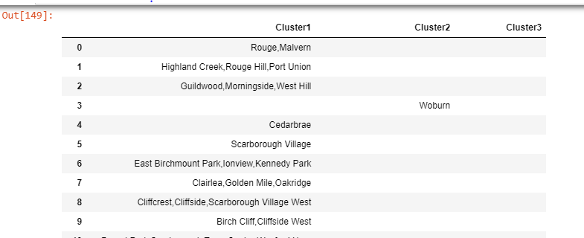
Methodology
  Dataset (Neighbourhoods) divided in 3 clusters based on most common venues

Slide 12
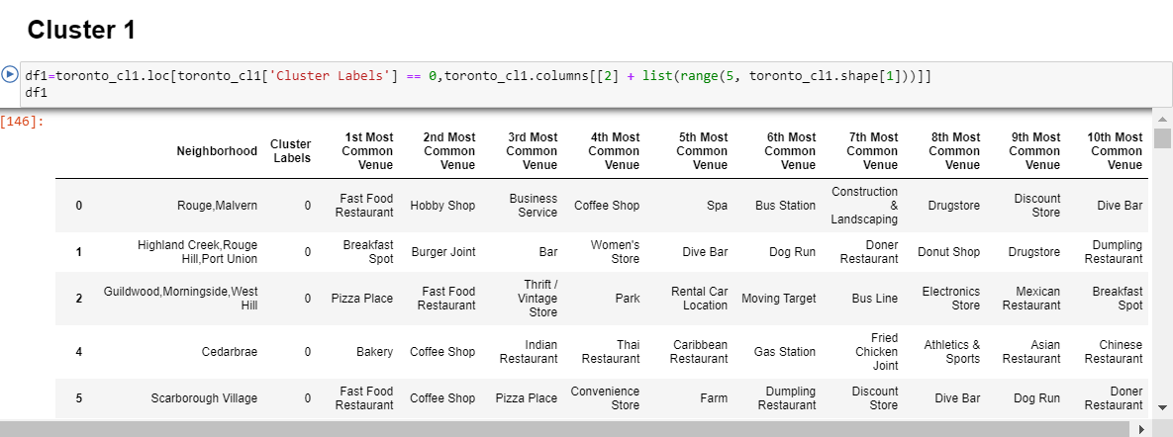
Results and Discussions
  Cluster 1 - Many fast food and speciality restaurants; coffee shops.
  Pretty much clustered through out the whole city of Toronto.
  very less parks and natural places in this neighbourhood. These places seem to be well populated and business friendly.

Slide 13
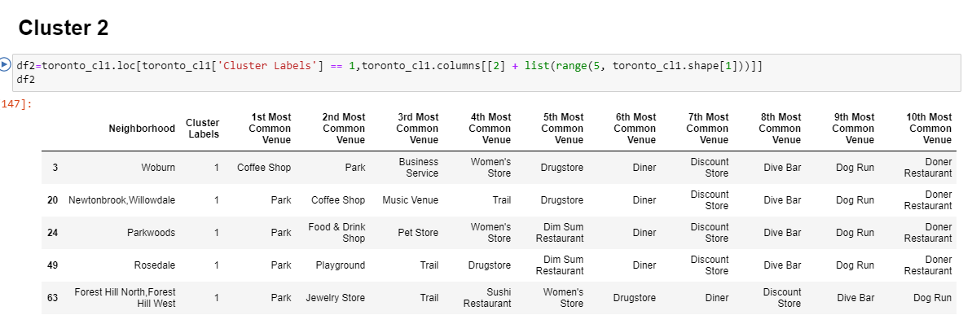
Results and Discussions
Cluster 2 - Many parks and trails.
There are only few assorted neighbourhoods in this cluster.
These places seem to be less populated and quiet.

Slide 14
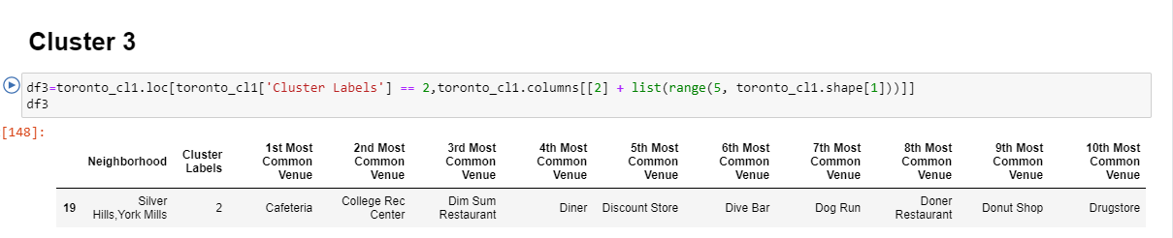
Results and Discussions
Cluster 3 - Unique neighbourhood with unique venues which are not common in cluster 1 and cluster 3.

Slide 15
Conclusion:
Neighbourhoods listed in cluster 2 best suites for client to chose a location that meets client's requirement since parks, coffee shops, drug stores and trails are the amongst the top 5 most common venues around this neighbourhood.
  Woburn
  Newtonbrook
  Willowdale
  Parkwoods
  Rosedale
  Forest Hill North
  Forest Hill West
Note: Hospital is not a most common venue in any of these neighbourhood.
According to this analysis it is evident that the neighbourhood of Newtonbrook and Willowdale (North York/Postal code:M2) is the most fit location for this client since all venues that client would want for their new house location are common in this neighbourhood
The best suited location to buy new house for client:
  Newtonbrook and Willowdale (North York/Postal code:M2)

